Slide 1
Columbia Business School Info-Touchscreen Redesign
Mockup by Dan Schlosser

Slide 2
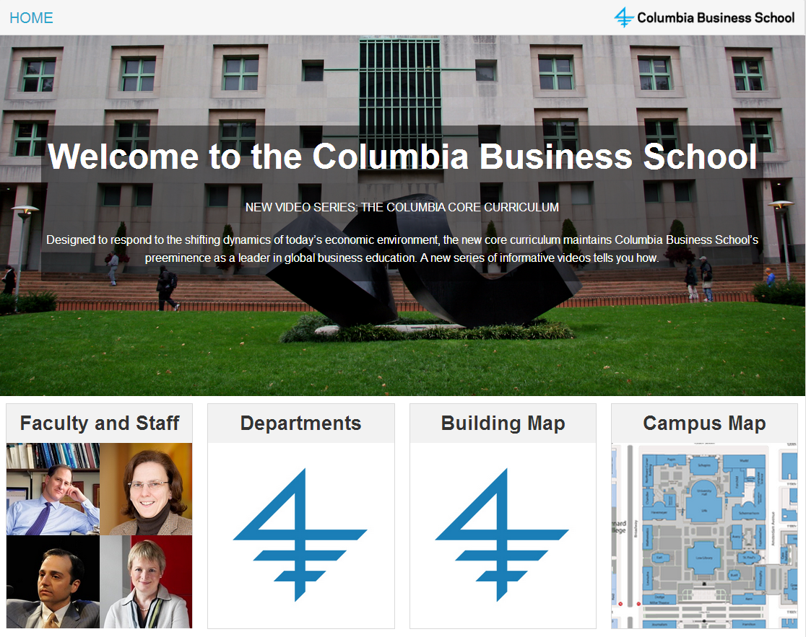

Slide 3
Big, beautiful cover image

Slide 4
The latest news will cycle here.

Slide 5
The entire panel is clickable

Slide 6
Images animate in and out, cycling through staff

Slide 7


Slide 8
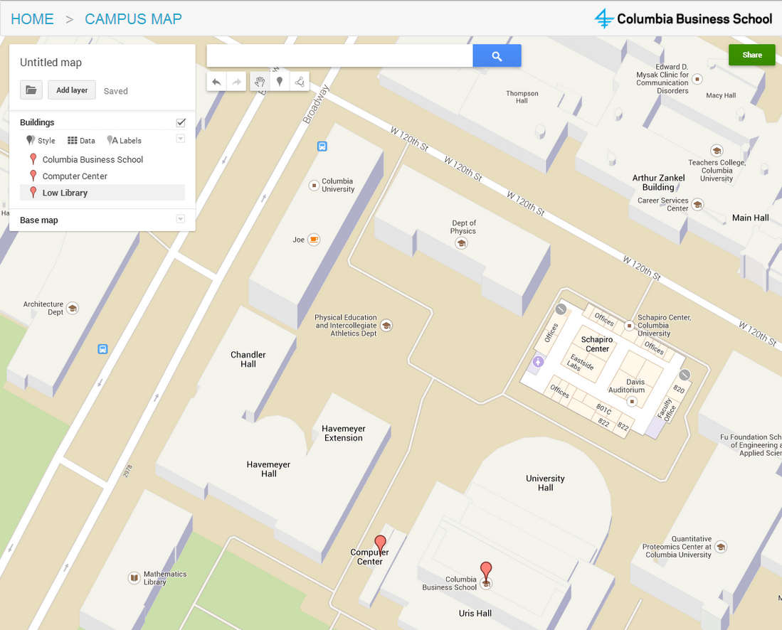

Slide 9
Large, rich, familiar, multitouch-enabled Google Maps instance
5/5 UX participants asked for a multi-touch zooming map
4/5 wanted to pan

Slide 10
Breadcrumbs allow for easy navigation from anywhere in the interface

Slide 11
Choose from a list of commonly searched for locations

Slide 12
And find them on the map

Slide 13
Search (virtual keyboard) is available through Google

Slide 17
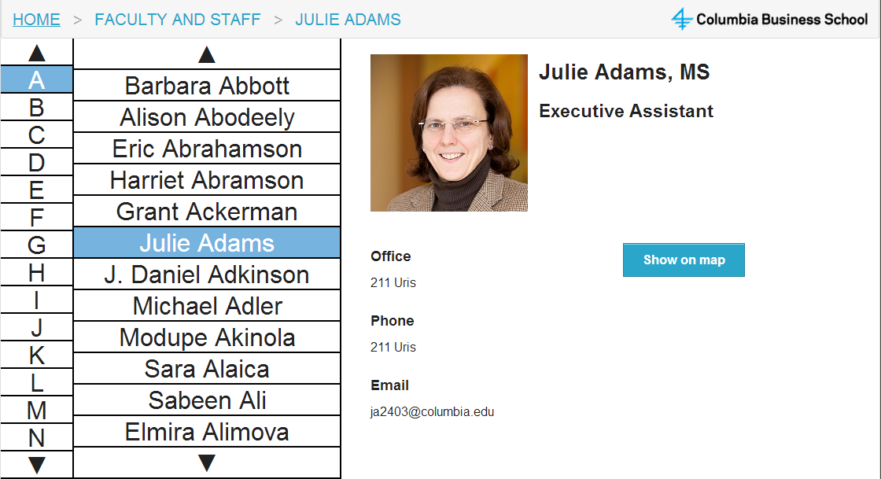

Slide 18
Single pane layout to avoid confusion
Navigation was a big problem UX testers

Slide 19
Multiple layers of breadcrumbs, all available

Slide 20
Names scrollable by swipe

Slide 21
Or by scroll buttons

Slide 22
Or by scroll buttons

Slide 23
Or by scroll buttons

Slide 24
All necessary info is in this pane.

